Slide 1
Azure Container Registry Overview
Steve Lasker
Principal Program Manager
Azure Container Registries
@SteveLasker

Slide 2
Presenter guidance
Title | Containers Registries in Azure and Microsoft
Main Object
Audience | TDMs
Delivered by
Content Level | 200
Deck Owner | Steve Lasker
Usage Guidance | 30 min discussion and deep dive to respective service(s) for selected scenario(s)
Version | 1.4
NEXT: <next slide title>

Slide 3

ACR: Today, Tomorrow and Beyond
Container Artifacts
Images (Docker & OCI)
Helm Charts
Meta-data
Security
Stored
Authenticated
Scanned
Signed
Geo Replicated and Redundant
OS & Framework Patching
Image Management
Import
Purge Policies
Eventing
Webhooks
Event Grid
Best Practices

Slide 4

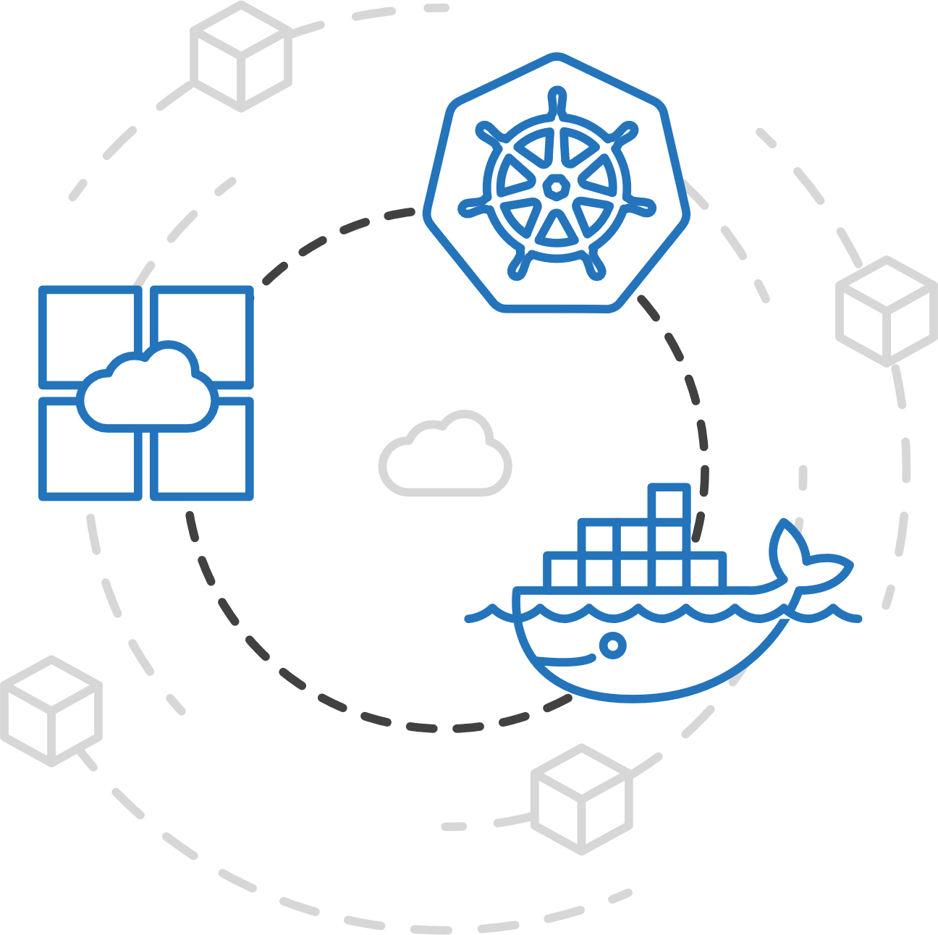
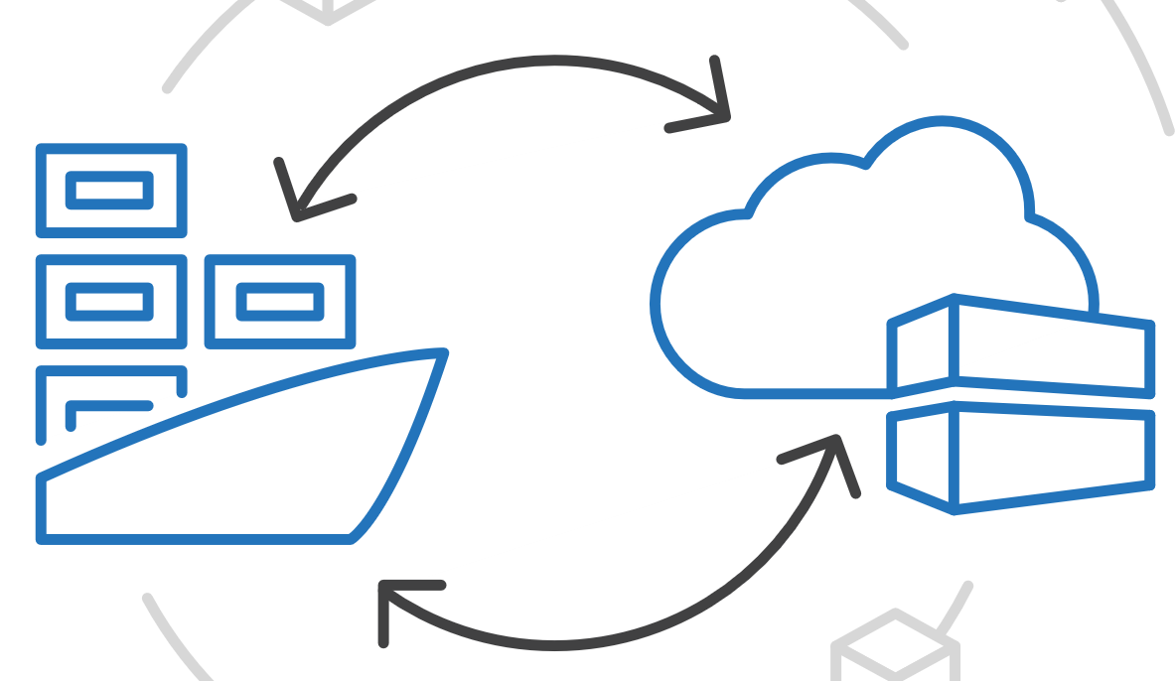
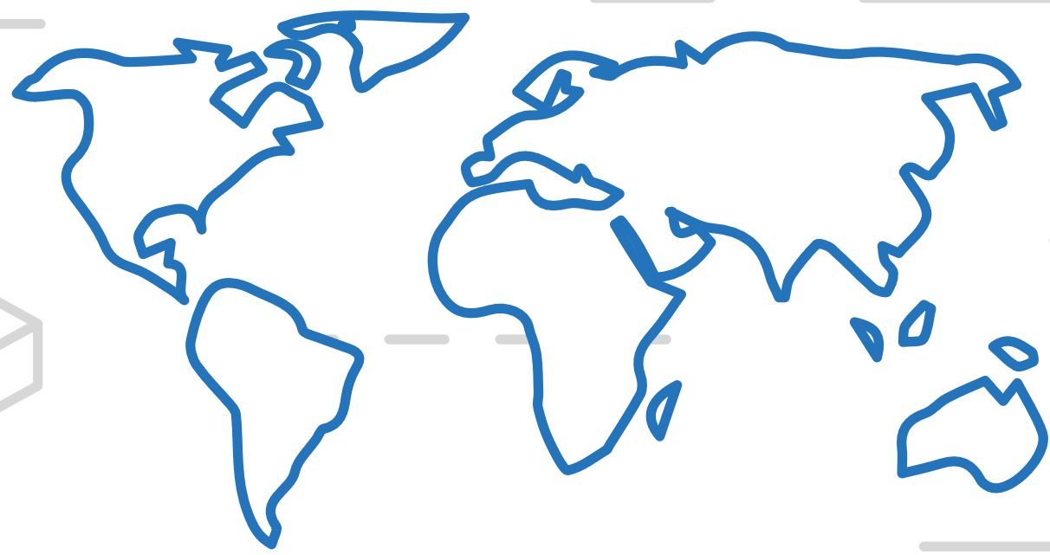


Azure Kubernetes Service (AKS)
Azure Container Registry (ACR)
Manage a Docker private registry as a first-class Azure resource
App Service
Azure Container Instances (ACI)
Service Fabric
Manage images for all types of containers
Use familiar, open-source Docker CLI tools
Azure Container Registry geo-replication
Azure Batch
Azure Container Registry (ACR)

Slide 5
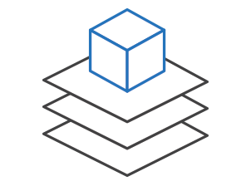
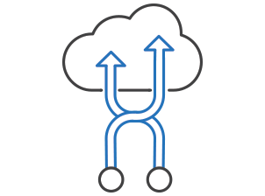
Trust Manage, monitor, and secure your containers
Flexibility
Productivity
Trust
Efficiently manage container images
Manage a Docker private registry as a first-class Azure resource with Container Registry. Manage container images with familiar, open-source Docker command-line interface (CLI) tools.
Gain visibility into your containers
Get a full view of your container deployment. View centralized CPU, memory, storage, and network and performance information with tools like Application Insights and Log Analytics.
Integrate security with container applications
Provide full-stack security for your containers including vulnerability scanning, run-time protection, and compliance. Add single sign-on with Azure Active Directory.

Slide 6

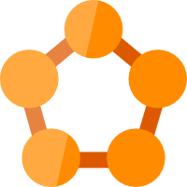













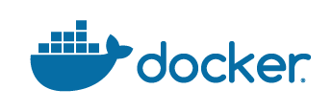


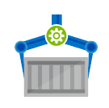
Azure Container Registry
App Service
Service Fabric
Kubernetes Service
Container Instance
Batch
Webhooks
Event Grid
Scanned, Secure & Signed
Azure Container Registry
Azure Security Center
Signed w/Content Trust
Build & Patch with ACR Tasks

Slide 7
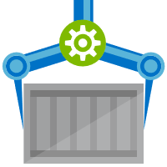


Release Management
Resource Pool
Orchestration
HOST-A
Deploy:
web:1 x3
quotes:1 x3
important:1 x4
Image Cache
3
web:1
digest: 91e
web:1
digest: 91e
Foo:
web:1 x3
quotes:1 x3
important:1 x4
web:1
digest: 91e
quotes:1
digest: u82
Container Builder
important:1
digest: 2re
important:1
digest: 2re
Container Registry
HOST-B
Image Cache
quotes:1
digest: u82
quotes:1
digest: u82
7
6
quotes:1
digest: u82
5
web:1
digest: 91e
important:1
digest: 2re
important:1
digest: 2re
important:1
digest: 2re
quotes:1
digest: u82
1
quotes:1
digest: u82
docker build –t web:1
docker build –t quotes:1
docker build –t important:1
docker push web:1
docker push quotes:1
docker push important:1
important:1
digest: 2re
important:1
digest: 2re
Image
web:1
quotes:1
important:1
2
Digests
91e
u82
2re
web:1
digest: 91e
HOST-C
quotes:1
digest: u82
4
important:1
digest: 2re
8
Image Cache
quotes:1
digest: u82
quotes:1
digest: u82
important:1
digest: 2re
important:1
digest: 2re
Notes:
Orchestrator icon from: http://cdn.marketplaceimages.windowsphone.com/v8/images/f58edb21-b20c-4315-b837-6cee21n442cd?imageType=ws_icon_large
https://git-scm.com/book/en/v2/Git-Branching-Basic-Branching-and-Merging

Slide 8
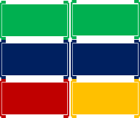
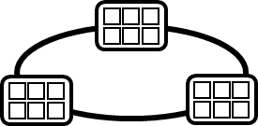
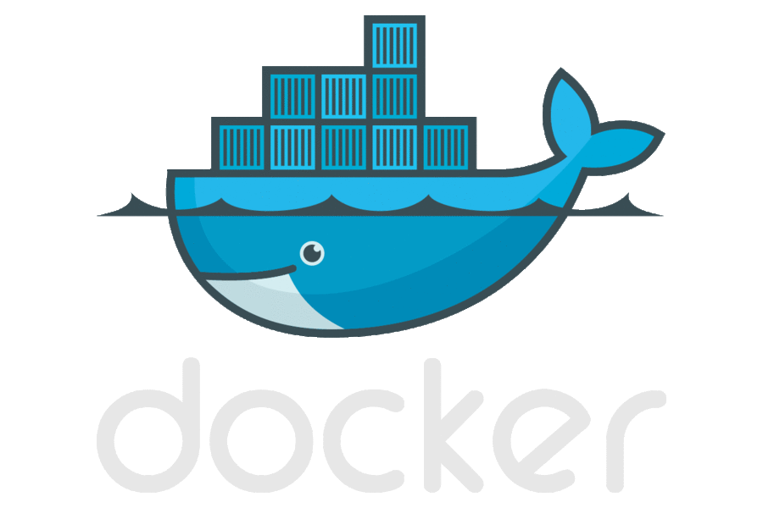
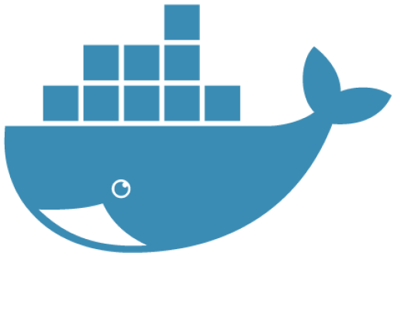


Container DevOps Workflow
Container Service
OS & Framework Patching
What happens when developers stop making code changes?
Run, Manage
Service Fabric
Source Code Control
(SCC)
Build/CI,
Integrate,
Test
CD, Deploy
App Services
Production
environments
Batch
Base Image Index
…
Docker Hub
Azure Container _Builder*
Azure Container Registry
…
Inner-Loop
…
Run
Monitor and Diagnose
Code
Validate
Debug

Slide 9
Azure Kubernetes Service (AKS)
Azure Container Registry Tasks
Run task based jobs using graphs of containers
App Service
Azure Container Instances (ACI)
Enable applications and algorithms to easily and efficiently run in parallel at scale.
Run Batch tasks without having to manage an environment and dependencies.
Package, execute, and scale your High Performance Computing applications and batch workloads in a consistent, reproducible manner.
Service Fabric
Azure Batch
Azure Container Registry (ACR)

Slide 10
Container Security
Encrypted At Rest
RBAC Authenticated
Quarantined – providing secure by default registries
Scanned by leading industry partners
Image Signing w/Content Trust

Slide 11
Registry Storage
Encrypted At Rest
Geo-redundant storage for all tiers – ^{Azure Storage GRS}
Docker & OCI Image Formats
Helm Charts – first public cloud to support Helm Chart Repos
Providing multi-container, parameterized definitions

Slide 12

Authenticating
Role Based Access Control (RBAC)
User Authentication
Service Authentication
Role | Create/Delete Registries | Repository/Tag Listing | Docker Push | Docker Pull | Update Quarantine Status | Docker Pull Quarantined Images
Owner
Contributor
Reader
acr-push*
acr-pull*
Quarantine-writer
Quarantine-reader
* Coming H1-2019

Slide 13
User Authentication
Using familiar docker CLIs
Individual Identity, using Azure Active Directory Identity
az login
az acr login --name demo42
docker push / pull

Slide 14
Service Authentication
Server/Headless identity using AAD Service Principals
Provision Service Principals, with scoped access control
Contributor – Push/Pull
Reader – Pull Only
Eg: assign the Kubernetes created principal, with reader role
az login --service-principal \
--tenant wabbit.com \
-u http://myapp-id \
-p WeryWerySecwet
az acr login --name demo42
docker push / pull
docker login demo42.azurecr.io \
-u http://myapp-id \
-p WeryWerySecwet
docker push / pull

Slide 15
*Container Registries Secured by Default
Enabling Secure By Default Registries
* Private Preview Q4 2018

Slide 16





Secured By Default
Build/Push
Azure Container Registry
Container Hosts
Quarantine Tag
Digest
Tag
91efj6
:1.0
:1.1
u82lq
:1.2
e8s1f
Shifting the container scanning to the left
Partnering with:

Slide 17
Container Service
Run, Manage
1
Release Management
Container Instances
docker push acrdemos.azurecr.io/th:1.0
Azure Container Registry
Production
environments
App Services
5
6
2
{
"id": "0d799b14-404b-4859-b2f6-50c5ee2a2c3a",
"timestamp": "2018-02-28T00:42:54.4509516Z",
"action": "push-quarantined",
"target": {
"size": 1791,
"digest": "sha256:91ef6
"length": 1791,
"repository": “th",
"tag": "1.0"},
"request": {
"id": "978fc988-1e06-49ee-bf71-4f6e331d1591",
"host": “acrdemos.azurecr.io",
"method": "PUT"}
}
{
"id": "0d799b14-404b-4859-b2f6-50c5ee2a2c3a",
"timestamp": "2018-02-28T00:42:56.4509516Z",
"action": "push",
"target": {
"size": 1791,
"digest": "sha256:91ef6
"length": 1791,
"repository": “th",
"tag": "1.0"},
"request": {
"id": "978fc988-1e06-49ee-bf71-4f6e331d1591",
"host": “acrdemos.azurecr.io",
"method": "PUT"}
}
3
docker pull th@sha256:91ef6
4
az acr policy set –n acrdemos --quarantine-remove –-image th@sha256:91ef6
or
az acr policy set –n acrdemos --quarantine-block –-image th@sha256:91ef6
Notes:
{
"id": "0d799b14-404b-4859-b2f6-50c5ee2a2c3a",
"timestamp": "2018-02-28T00:42:54.4509516Z",
"action": "push-quarantined",
"target": {
"mediaType": "application/vnd.docker.distribution.manifest.v2+json",
"size": 1791,
"digest": "sha256:91ef6
"length": 1791,
"repository": “th",
"tag": "1.0"
},
"request": {
"id": "978fc988-1e06-49ee-bf71-4f6e331d1591",
"host": "jengademos.azurecr-test.io",
"method": "PUT",
"useragent": "docker/18.03.0-ce-rc1 go/go1.9.4 git-commit/c160c73 kernel/4.9.75-linuxkit-aufs os/linux arch/amd64 UpstreamClient(Docker-Client/18.03.0-ce-rc1 \\(windows\\))"
}
}

Slide 18
Quarantine – Image Access
docker push acrdemos.azurecr.io/th:1.0
docker push acrdemos.azurecr.io/th:1.0
docker pull th@sha256:91ef6
docker pull th@sha256:e8s1f
az acr policy set –n acrdemos --quarantine-remove –-image th@sha256:91ef6
az acr policy set –n acrdemos --quarantine-remove –-image th@sha256:e8s1f
docker push acrdemos.azurecr.io/th:1.1
docker push acrdemos.azurecr.io/th:1.0
docker pull th@sha256:u82lq
docker pull th@sha256:3r2s7
az acr policy set –n acrdemos --quarantine-remove –-image th@sha256:u82lq
az acr policy set –n acrdemos --quarantine-fail –-image th@sha256:3r2s7
Tag
Digest
91efj6
u82lq
e8s1f
3r2s7
Quarantine Tag
:1.0
:1.1
:1.0
:1.0

Slide 19

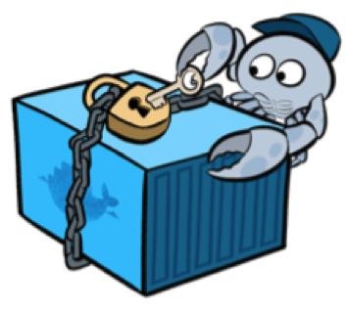

Image Signing Content Trust
Securing images from source to destination
* Public Preview Q4 2018

Slide 20




Content Trust
docker push
docker pull
acr
 Content Trust Enabled,
api
api
Images
Signatures
* Public Preview Q4 2018

Slide 21




Local Cache of a Docker Image
Pull:
I want this “thing”, represented by a collection of layers
docker pull microsoft/windowservercore
Manifests
1. Pull
Manifest:
List of layer ID’s representing the entire thing
Manifest:
What layers do I already have? ^{(decompressed)}
2. Manifest Returned
helloworld
3. Delta Layer Requests
dotnetframework
windowwservercore
Image Cache
IMAGE ID REPOSITORY TAG SIZE
694950fbcb3f microsoft/windowsservercore latest 10.4GB
4. Layer URLs Returned
Layers Please:
List of compressed blob URLs
Compressed Layers
5. Layer Request
cf4ecb49238476635f551fe11987ae4c3
e41864ee12411ff073f0a58417cf7e160
85bef57c324acc96f7067488d35b7e3c1
Layer Cache
LAYER ID
1d57d886885835cbc52c2d85fe0ce008f
6. Layers Returned
f78a85a7da099d7494a5166a28e72a642
sha256:cf4ecb49238476635f551fe11987ae4c3
da3343b41a78a0bcd4926d605b6fe37ba
sha256:e41864ee12411ff073f0a58417cf7e160
c935edcb03a0660b347d2fbf6542ee068

Slide 22
Local Cache of an Image
docker pull microsoft/dotnet-framework
Manifests
1. Pull
Manifest:
What layers do I already have? ^{(decompressed)}
2. Manifest Returned
helloworld
3. Delta Layer Requests
dotnetframework
windowwservercore
Image Cache
IMAGE ID REPOSITORY TAG SIZE
694950fbcb3f microsoft/windowsservercore latest 10.4GB
210sdfsdf4da microsoft/dotnet-framework latest 11.6GB
4. Layer URLs Returned
Compressed Layers
5. Layer Request
cf4ecb49238476635f551fe11987ae4c3
e41864ee12411ff073f0a58417cf7e160
85bef57c324acc96f7067488d35b7e3c1
Layer Cache
LAYER ID
1d57d886885835cbc52c2d85fe0ce008f
6. Layers Returned
f78a85a7da099d7494a5166a28e72a642
sha256:cf4ecb49238476635f551fe11987ae4c3
da3343b41a78a0bcd4926d605b6fe37ba
sha256:e41864ee12411ff073f0a58417cf7e160
c935edcb03a0660b347d2fbf6542ee068
sha256:e41864ee12411ff073f0a58417cf7e160

Slide 23
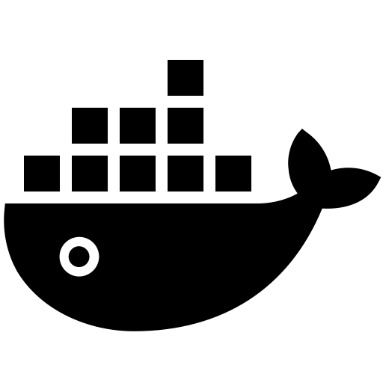
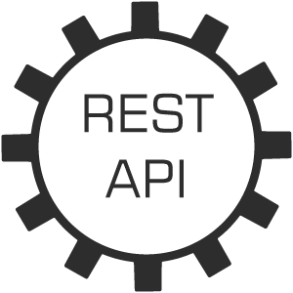


docker daemon
1
docker pull contoso.azurecr.io/widget/webapi
return image manifest
request delta layers
return blob urls w/sas tokens
Azure
Active Directory
docker client
request layer blobs
2
Layer Cache
sha256:cf4ecb492384766
return compressed blobs
sha256:e41864ee12411ff
sha256:e41864ee12411ff

Slide 24
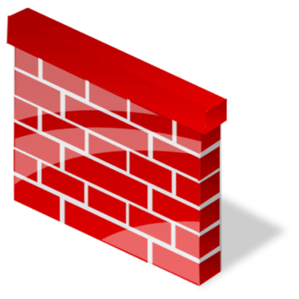

Slide 25

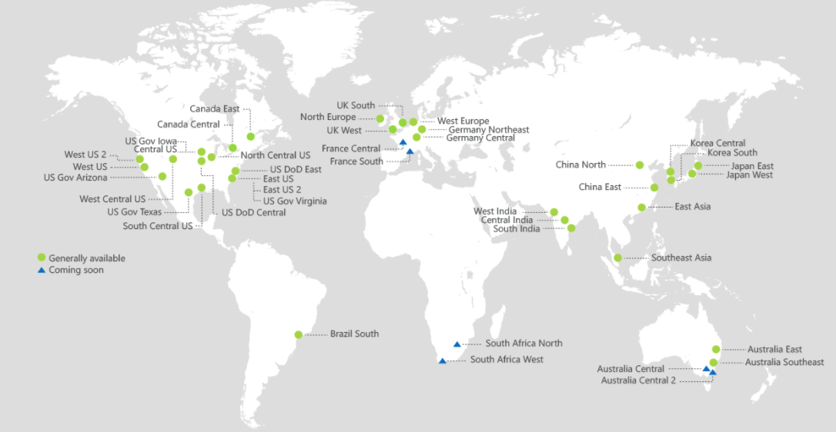
ACR Geo-replication
Mange global/local deployments as one resource
Geo-redundant for active-active-active failover
http://aka.ms/acr/geo-replication

Slide 26
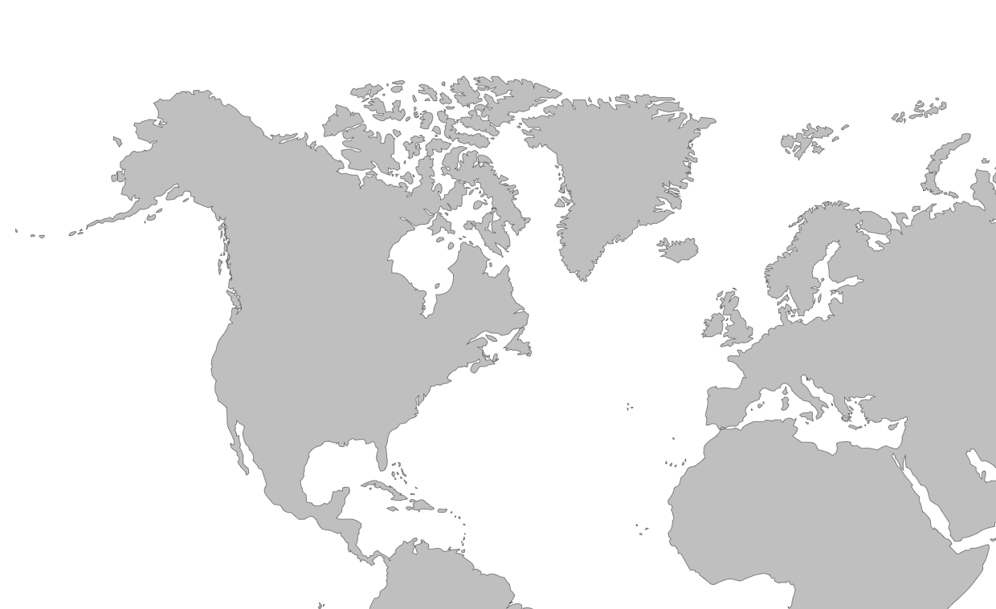

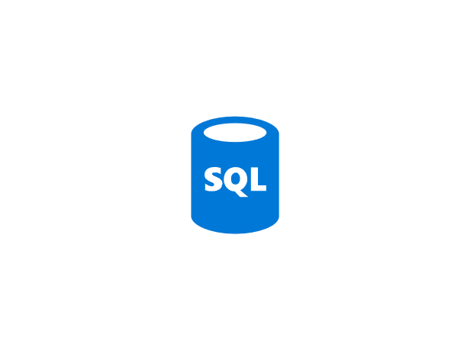

Push Built Images
docker push contosowestus.azurecr.io/web:1234
docker push contosowesteurope.azurecr.io/web:1234
Nodes Pull Images
docker pull contosowestus.azurecr.io/web:1234
docker pull contosowesteurope.azurecr.io/web:1234
Pulls are local, network-close, fast, reliable
Pulls are remote, across the public internet, slower, less reliable
Have network egress fees
Pulls are remote, across the public internet, slower, less reliable
Have network egress fees
West Europe
Canada Central
West US
East US
Developers must push images to n registries, requiring separate management and configuration

Slide 27
Push Built Images
docker push contoso.azurecr.io/web:1234
ACR Syncs Image Blobs
Regional Web Hooks fire for local deployments
Nodes Pull Images
docker pull contoso.azurecr.io/web:1234
Geo-replicate a single registry
All regions have a local replica
Geo-replicate a single registry
All regions have a local replica
West Europe
Canada Central
West US
East US
Each registry is pulling from a local, network close, reliable registry

Slide 28
Azure Container Registry
Providing a single registry across the globe
aka.ms/ACR
aka.ms/ACR/Docs
aka.ms/ACR/Geo-replication
aka.ms/ACR/Roadmap

Slide 29
Geo-replication Details
Regions are multi-master
Each Docker push creates new image layers, eliminating normal update conflicts
Updating an existing tag; last writer wins, and will be eventually consistent across all regions
Push supported to any region; replicated to others
RBAC shared across all regions
Each region has geo-redundant, encrypted at rest storage
Replicates Images, Helm Charts, Metadata

Slide 30
Geo-replication Details
Each region billed as a premium registry
Storage and throughput, metered per registry
Configured through the portal, or az cli
Regional Webhooks and Event Grid notifications

Slide 31
ACR Tasks
A feature of Azure Container Registry
aka.ms/acr/tasks
Providing OS & Framework Patching
Task execution of a graph of containers

Slide 32




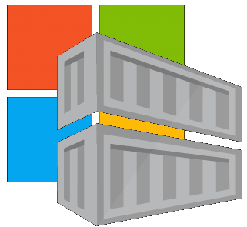

Container Lifecycle Primitives
Host agents monitor, protect and report running containers
3
Container Service
Container Instances
Source Code Control
(SCC)
Build/CI,
Integrate,
Test
CD, Deploy
7
App Services
Upon release, set released flag in ACR (ACR-Auto-purge policies)
Service Fabric
.NET
6
Base Image Index
4
8
1
2
Azure Functions
Docker Hub
ACR Build
Azure Container Registry
IoT
Azure Container Registry
Image Security Scanning
Secure by default
Microsoft Container Registry
Inner-Loop
Azure Batch
Run
5
Code
Validate
Debug
* Work in progress

Slide 33
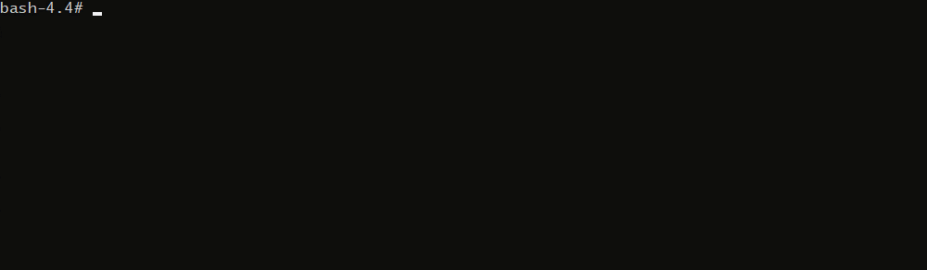
Container Lifecycle Primitives

Slide 34




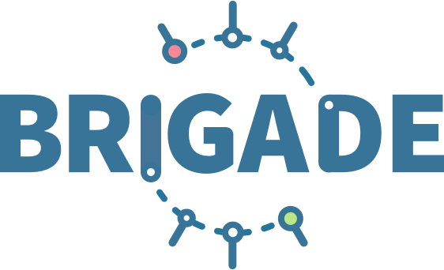


Container OS & Framework Patching
.NET
Registries
Docker Hub
MCR
ACR
Build Triggers
SCC Providers
ACR Tasks
Azure Container Registry
aka.ms/acr/tasks

Slide 35


Dockerfile FROM
Build-task
Functional Tests
Base Images
Commit Id
Id
Context
Dependencies
ACR
d5ab1fa
fx:1
fx:1^{(a)}
fx:1
Web-Build
1
fx:1
web:sha@la
web:1
deploy/test
deploy
web:1
web:1
test:t
Context
d5ab1fa
test:1
Dependencies
web:1
Integration Env
FROM jenga.azurecr.io/baseimages/fx:1
COPY . /output
EXPOSE 80
ENTRYPOINT ["entryPoint"]
If docker build succeeds (including any unit tests),
Save the context & base image dependencies
web:1
az acr build-task create \
–n Web-Build \
–t web:${{.Build.ID}} \
–c github.com/demo42/web \
–-git-access-token $PAT \
–r jenga
Staging Env

Slide 36
Dockerfile FROM
Build-task
Functional Tests
Base Images
Commit Id
Id
Context
Dependencies
ACR
fx:1^{(a)}
fx:1
d5ab1fa
Web-Build
1
fx:1
web:sha@la
web:1
deploy/test
deploy
Context
fx:1^{(b)}
fx:1^{(b)}
2
fx:1^{(b)}
web:sha@ya
web:2
deploy/test
deploy
web:2
web:2
d5ab1fa
test:2
test:2
Dependencies
fx:1^{(a)}
web:2
fx ships an OS &/or FX Patch, using the stable 1 tag
The build-task is monitoring changes based on the last build
Integration Env
Base image updates restore the previous context
If Build & Unit Tests Succeed,
Update the base image dependencies
web:2
Staging Env

Slide 37
Dockerfile FROM
Build-task
Functional Tests
Base Images
Commit Id
Id
Context
Dependencies
ACR
d5ab1fa
Web-Build
fx:1
fx:1^{(a)}
fx:1
Web-Build
1
web:sha@la
web:1
deploy/test
deploy
Context
fx:1^{(b)}
fx:1^{(b)}
2
fx:1^{(b)}
web:sha@ya
web:2
deploy/test
deploy
web:2
web:2
ef26q5c
test:2
d5ab1fa
test:3
fx:2^{(d)}
fx:2^{(d)}
fx:2
ef26q5c
3
fx:2^{(d)}
web:sha@qe
web:3
deploy/test
deploy
web:3
web:3
Dependencies
test:4
Dependencies
fx:1^{(a)}
fx:1^{(b)}
web:3
FROM jenga.azurecr.io/baseimages/fx:2
COPY . /output
EXPOSE 80
ENTRYPOINT ["entryPoint"]
Integration Env
web:2
web:3
If docker build succeeds (including any unit tests),
Save the context & base image dependencies
Staging Env
Container OS & Framework Patching

Slide 38

Contoso (Returns)
1 Pull Request
= 1 Build
= 1 Push
= 1 Scan
= 1 Test
= 1 Deploy
$$(1pr=1b+1p+ 1t+1d) ∗life of development$$
Contoso (*)
= 1 Build
= 1 Push
= 1 Scan
= 1 Test
= 1 Deploy
= 1 Build
= 1 Push
= 1 Scan
= 1 Test
= 1 Deploy
= 1 Build
= 1 Push
= 1 Scan
= 1 Test
= 1 Deploy
.NET
Northwind
= 1 Build
= 1 Push
= 1 Scan
= 1 Test
= 1 Deploy
= 1 Build
= 1 Push
= 1 Scan
= 1 Test
= 1 Deploy
= 1 Build
= 1 Push
= 1 Scan
= 1 Test
= 1 Deploy
Smart Hotel 360
= 1 Build
= 1 Push
= 1 Scan
= 1 Test
= 1 Deploy
= 1 Build
= 1 Push
= 1 Scan
= 1 Test
= 1 Deploy
= 1 Build
= 1 Push
= 1 Scan
= 1 Test
= 1 Deploy
Adventure Works
= 1 Build
= 1 Push
= 1 Scan
= 1 Test
= 1 Deploy
= 1 Build
= 1 Push
= 1 Scan
= 1 Test
= 1 Deploy
= 1 Build
= 1 Push
= 1 Scan
= 1 Test
= 1 Deploy
Fabrikam
= 1 Build
= 1 Push
= 1 Scan
= 1 Test
= 1 Deploy
= 1 Build
= 1 Push
= 1 Scan
= 1 Test
= 1 Deploy
= 1 Build
= 1 Push
= 1 Scan
= 1 Test
= 1 Deploy
$$1patch=cust ∗apps ∗ \left(1b+1p+ 1t+1d\right)∗life of the app$$

Slide 39
Helm Chart Repositories
Core Capability of Azure Container Registry
Store Helm Charts, alongside Images
Share common authentication
Geo-replicated & redundant

Slide 40
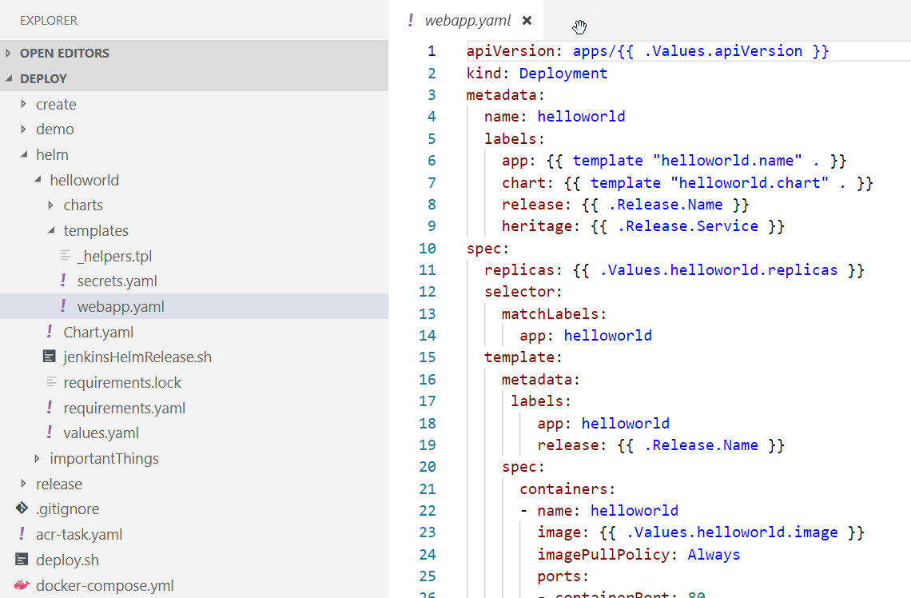
Helm Chart Repositories

Slide 41
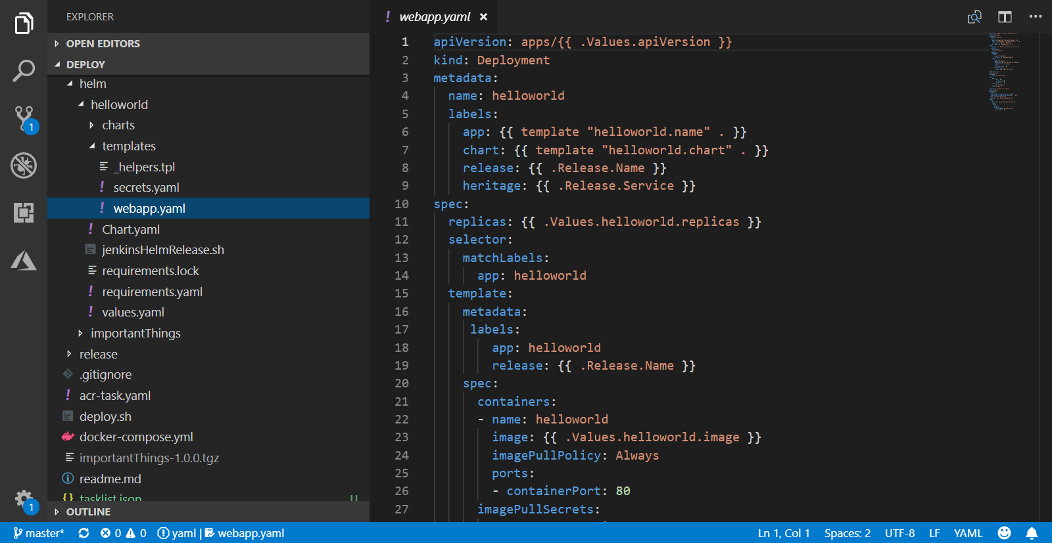
Helm Chart Repositories

Slide 42
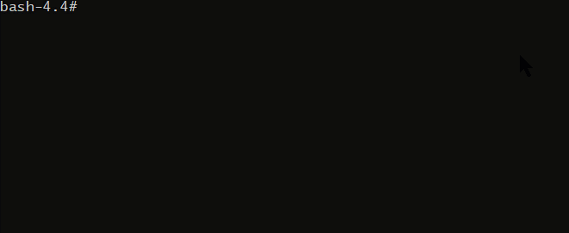
Helm Chart Repositories

Slide 43
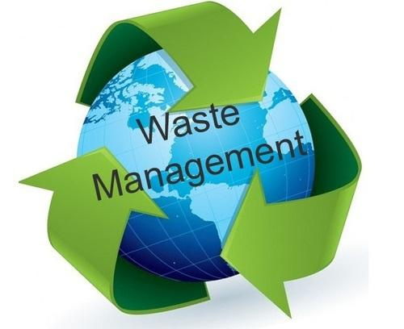
Image Policies
Managing image storage and lifecycle

Slide 44






Image Policies
Azure Container Registry
Policies
Quarantine 7 days
Default 14 days
Release 3 years
Released
TTL 1/1/21
Quarantined TTL 1/7/18
Default
TTL 1/14/18

Slide 45
Image Tagging Best Practices
Why stable tagging can create instability
https://stevelasker.blog/2018/03/01/docker-tagging-best-practices-for-tagging-and-versioning-docker-images/

Slide 46
HOST-A
Deploy:
web:1 x3
quotes:1 x3
important:1 x4
Image Cache
3
web:1
digest: 91e
web:1
digest: 91e
Foo:
web:1 x3
quotes:1 x3
important:1 x4
web:1
digest: 91e
quotes:1
digest: u82
quotes & important are in inconsistent states
1
important:1
digest: 2re
important:1
digest: 2re
docker build –t web:1
docker build –t quotes:1
docker build –t important:1
docker images
REPOSITORY TAG DIGEST
web 1 91e
quotes 1 u82
important 1 2re
docker push web:1
docker push quotes:1
docker push important:1
HOST-B
Image Cache
quotes:1
digest: u82
quotes:1
digest: u82
9
8
web:1
digest: 91e
5
important:1
digest: 2re
quotes:1
digest: 3rp
important:1
digest: 1n4
important:1
digest: 2re
quotes:1
digest: u82
quotes:1
digest: u82
important:1
digest: 2re
important:1
digest: 2re
Digests
91e
u82
2re
Image
web:1
quotes:1
important:1
2
Digests
91e
u82
2re
3rp
1n4
web:1
digest: 91e
HOST-C
quotes:1
digest: u82
7
4
important:1
digest: 2re
Image Cache
quotes:1
digest: 3rp
quotes:1
digest: 3rp
6
docker build –t quotes:1
docker build –t important:1
docker images
REPOSITORY TAG DIGEST
quotes 1 3rp
important 1 1n4
docker push quotes:1
docker push important:1
important:1
digest: 1n4
important:1
digest: 1n4
quotes:1
digest: 3rp
important:1
digest: 1n4
Notes:
Orchestrator icon from: http://cdn.marketplaceimages.windowsphone.com/v8/images/f58edb21-b20c-4315-b837-6cee21n442cd?imageType=ws_icon_large
https://git-scm.com/book/en/v2/Git-Branching-Basic-Branching-and-Merging

Slide 47
Tagging Techniques
Base Images
FROM …
Stable Tags
Tag
:latest
:1
:2
:3
:1.0
:1.1
:1.2
:2.0
:2.1
:3.0
Digest
91efj6
u82lq
2re7f
3rpn1
1n4ef
5wd1k
Servicing Stable Tags
Tag
:latest
:1
:2
:1.0
:1.1
:1.2
:2.0
Digest
91efj6
u82lq
e8s1f
1n4ef
2re7f
3rpn1
28efq
Deployed Images
docker run …
Unique Tagging
Tag
:12204
:12328
:12401
:33810
:35091
:4201
:50201
Digest
91efj6
u82lq
e8s1f
1n4ef
2re7f
3rpn1
28efq
Notes:
[‎2/‎23/‎2018 3:18 PM] Sajay Antony:
https://git-scm.com/book/en/v2/Git-Branching-Basic-Branching-and-Merging
[‎2/‎23/‎2018 3:37 PM] Sajay Antony:
https://docs.docker.com/storage/storagedriver/
[‎2/‎23/‎2018 4:00 PM] Sajay Antony:
https://www.cockos.com/licecap/
[‎2/‎23/‎2018 5:10 PM] Sajay Antony:
https://docs.docker.com/datacenter/dtr/2.4/guides/user/create-promotion-policies/

Slide 48


Image Instancing Performance
Azure Optimizations, to “go plaid” with ludicrous speed

Slide 49

*Hyper Scale with Azure CDN
Highest concurrent throughput
Thousands of concurrent node pull
* Coming H1-2019

Slide 50
Additional Features Coming 2018
Repo Level RBAC (Images & Charts)
Time Based Tokens
Public/Anonymous Access
Self Diagnostic Audit Logging
Image Usage Telemetry
Cert Based Authentication
Azure Stack
On-Prem Replicated Node
Gitlab Support

Slide 52
ACR Roadmap: H1 2018
Feature | Description
Existing VNET | Add ACR to an existing VNET
ACR Build | OS & Framework Patching
Additional Clouds | China, US Gov, Germany
Event Grid Integration | Base Image Updates, ACR Image Push, Delete
Overage Meters | Enabling customers that have large storage
Auto-Purge | Maintaining a pruned registry
Trusted Registries | Support Signed Images
ISO, HIPPA, HITRUST, PCI Compliance | Assure ACR adheres to the strictest compliance standards
Image Telemetry | Image pull statistics
Image Quarantine | Limiting access to newly pushed images, until vulnerability scanning completed
CDN Support | Additional performance to Premium Registries
http://aka.ms/acr/roadmap

Slide 53
ACR Tiered SKUs
Basic – Low cost entry point for developer POCs
Standard – Majority of dev & production scenarios with most common scale
Premium – HyperScale for larger, global deployments
Feature | Basic | Standard | Premium
Storage | 10 GiB | 100 GiB | 500 GiB
ReadOps per minute^{1, 2} | 1k | 300k | 10,000k
WriteOps per minute^{1, 3} | 100 | 500 | 2k
Download bandwidth MBps¹ | 30 | 60 | 100
Upload bandwidth MBps¹ | 10 | 20 | 50
Webhooks | 2 | 10 | 100
Geo-replication | N/A | N/A | Supported (preview)
SKUs http://aka.ms/acr/skus
¹ ReadOps, WriteOps, and Bandwidth are minimum estimates. ACR strives to improve performance as usage requires.+
² docker pull translates to multiple read operations based on the number of layers in the image, plus the manifest retrieval.
³ docker push translates to multiple write operations, based on the number of layers that must be pushed. A docker push includes ReadOps to retrieve a manifest for an existing image.

